Slide 1
Renal Doppler in Acute Care
Korbin haycock, md, facep, rdms, rdcs

Slide 2
Conflict of interest?
None

Slide 3
Key points:
What are the components of the intra-renal Doppler pattern, and what do they mean?
What is the physiological origin and basis of the intra-renal arterial and venous wave forms?
How can we apply (or not apply) the intra-renal Doppler to the patient in acute care?

Slide 4
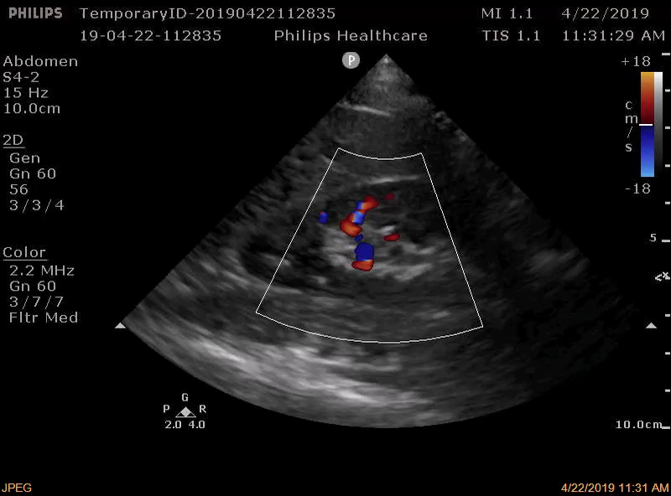
The Intra-renal Doppler Tracing

Slide 5
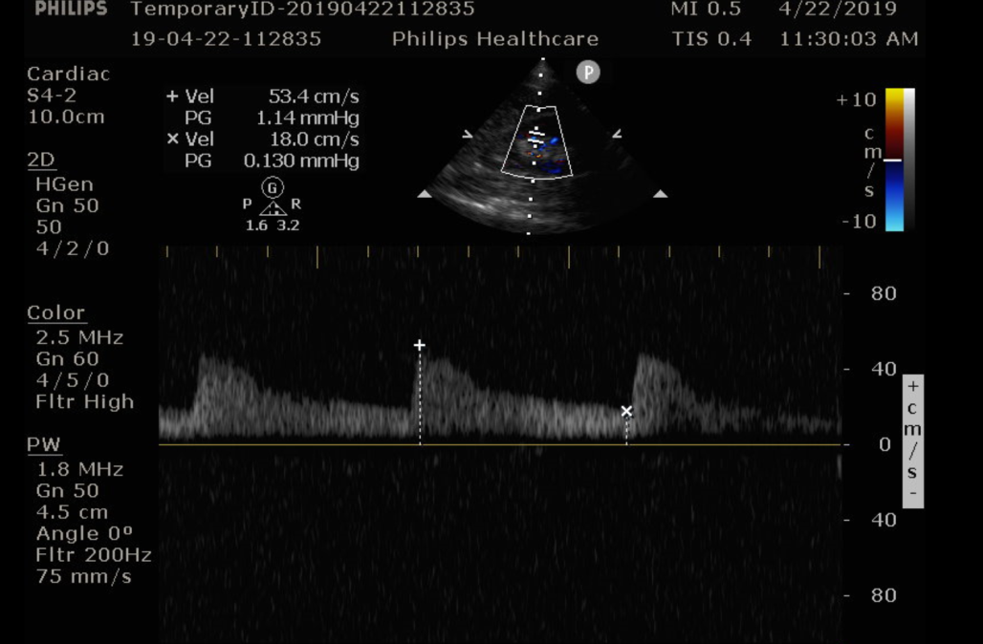
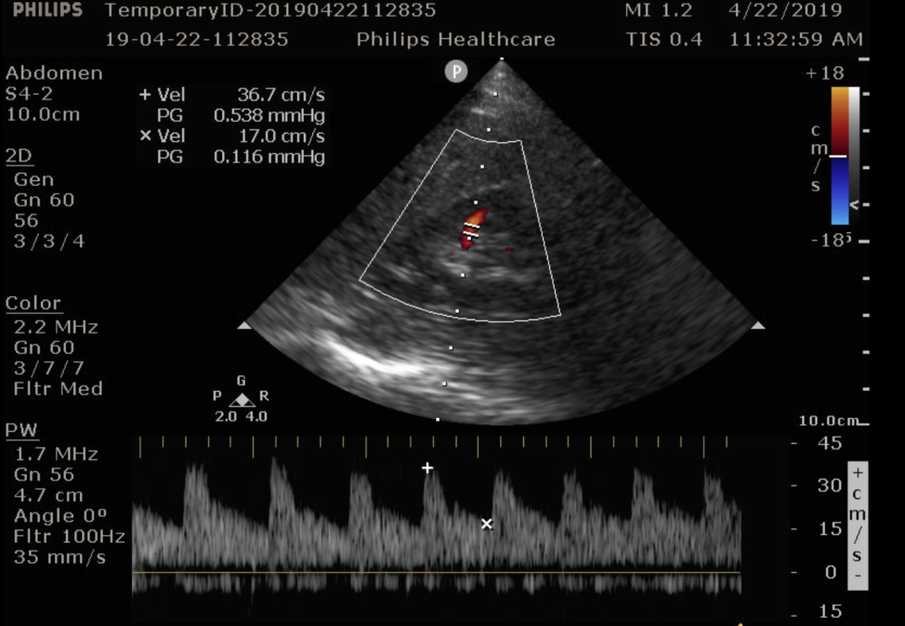
How to acquire the intra-renal Doppler

Slide 6
Acquisition recap
Use the phased array or curvilinear probe
Optimize color gain
Nyquist limit adjusted to 8-20 cm/sec for CFD
Gate the PW Doppler on the interlobar vessels
Adjust Nyquist limit on PW Doppler to maximize scale tracing without aliasing
For Renal Resistive Index: get upper pole, mid renal, and lower pole tracing for an average RRI if possible

Slide 7
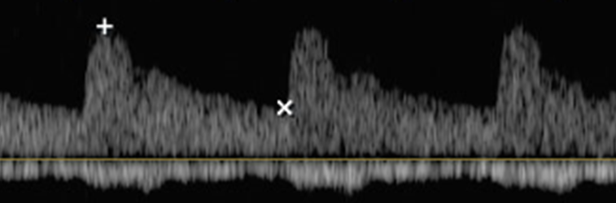



Renal resistive index
Resistive Index = Systolic peak velocity – End Diastolic Velocity/ Systolic peak velocity
The kidneys are high flow organs with vascular beds with a low RI
Normal RRI is <0.60 and abnormal is >0.70
Diastolic flows are more important to perfusion than systolic peak flows

Slide 8
What Determines the RRI?
O’Neill, 2014
SPV-EDV
Flow=Volume/Time
&
Flow=dP/R
RRI=
SPV
Volume/Time=dP/R
1-
EDV
SPV
LA * Distance traveled/Time = dP/R
Distance Traveled /Time = Velocity
dP
Velocity =
R * LA

Slide 9

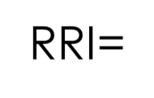

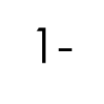


What Determines the RRI?
O’Neill, 2014
P1-P0
SPV-EDV
RRI=
SPV
1-
EDV
SPV
Pd-P0
LAs
dP
x
Velocity =
Ps-P0
LAd
R * LA

Slide 10
What Determines the RRI?
O’Neill, 2014
3 determinates of the RRI:
  1) Ratio of diastolic to systolic blood pressure
    Inverse of pulse pressure
  2) P0
    Interstitial pressure + Venous back pressure
      The renal capillary wedge pressure
  3) Ratio of Lumen area in systole and diastole
    This is a function of vascular compliance
Pd-P0
LAs
x
Ps-P0
LAd

Slide 11
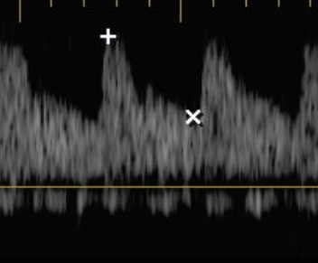
RRI-Major determinants
Systolic Determinants
Diastolic Determinants
--Pulse pressure
--Left ventricular outflow
--Large arteries and aortic vascular compliance
--Heart rate
--Renal capillary wedge pressure
--Renal resistance
Nicolo, 2018

Slide 12
RRI affected by:
(Nicolo, 2018)
Systolic Peak Velocity
End Diastolic Velocity
Heart Failure
Aortic Stenosis
Aortic Coarctation
Aortosclerosis
Renal Artery Stenosis
Sepsis
Hypovolemia
Heart Failure
Heart Rate
Arteriolosclerosis
Chronic Kidney Disease
Acute Kidney Disease
Obstructive Uropathy
Hypoxia/Hypercapnia
Hemorrhage
Drugs (BB, diuretics, ACEI)

Slide 13
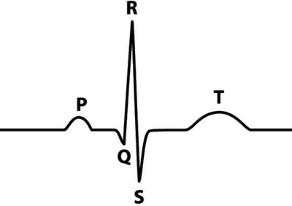
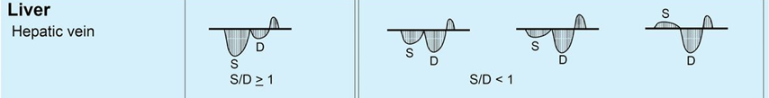
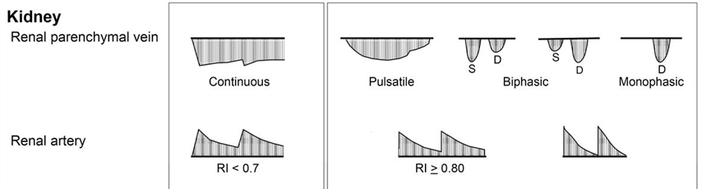
Intrarenal Venous Doppler
The IRVD pattern changes as venous congestion and RAP increase
a
v
y
x
(Tang, 2016)

Slide 14
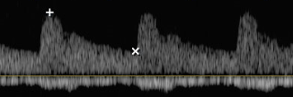
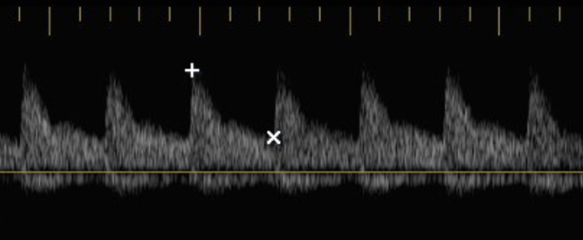
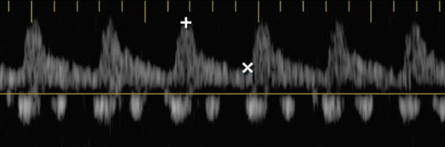
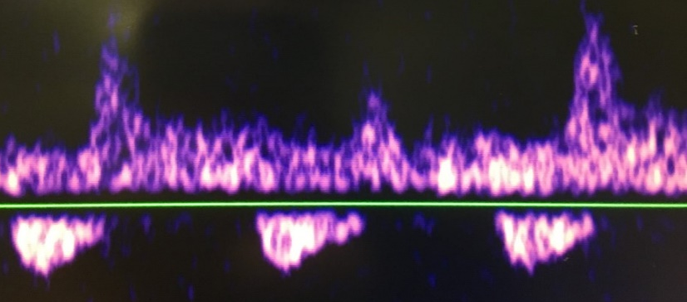
Intrarenal Venous Doppler

Slide 15
Putting it all together
When interpreting the intrarenal waveform remember that it is generated by multiple factors
  Peak systolic velocities are mainly influenced by systemic hemodynamic factors
  End diastolic velocities are more influenced by local hemodynamic factors
  Intrarenal venous patterns inform about renal interactions with venous congestion and RV function

Slide 16
RRI applications in acute care
We’ll briefly cover:
  CHF and venous congestion
  Trauma
  Sepsis
Other possible applications:
  Obstructive uropathy
  CKD
  Diabetic nephropathy
  Multiple organ failure

Slide 17
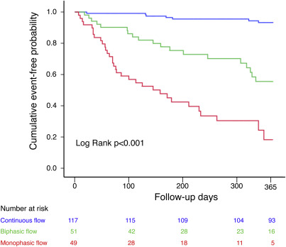
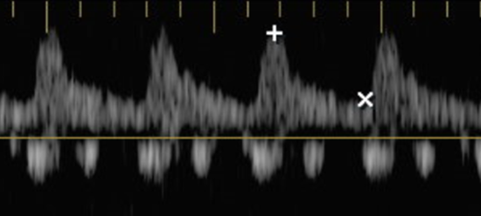
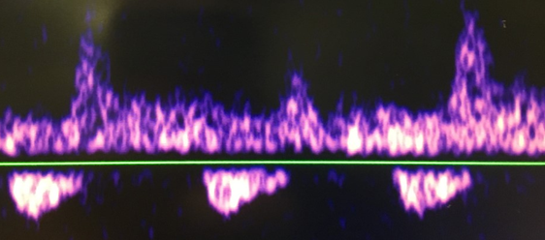
Intrarenal Doppler in CHF
IRVF pattern is associated with worsening prognosis
  (Iida, 2016)
Notes:
Predicted better than EF, E/e’, CVP, Na, GFR, BNP, FAC, HVD

Slide 18
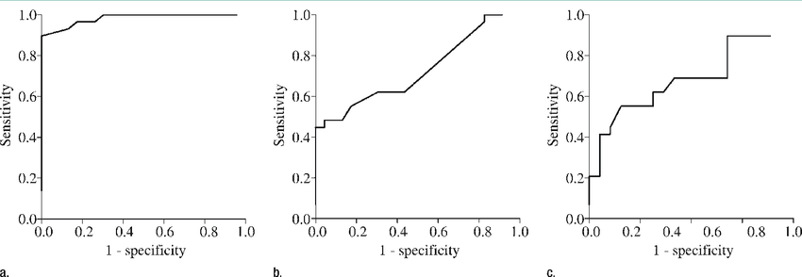
RRI applications in Trauma
Trauma:
  RRI predicts which hemodynamically stable ED patients will develop hemorrhagic shock (Corradi, 2011)
RRI >0.7
ISS >25
Standard Base Excess <-2.8
Sen 90, Spec 87, AUC 0.98
Sen 97, Spec 17, AUC 0.74
Sen 58, Spec 72, AUC 0.74

Slide 19
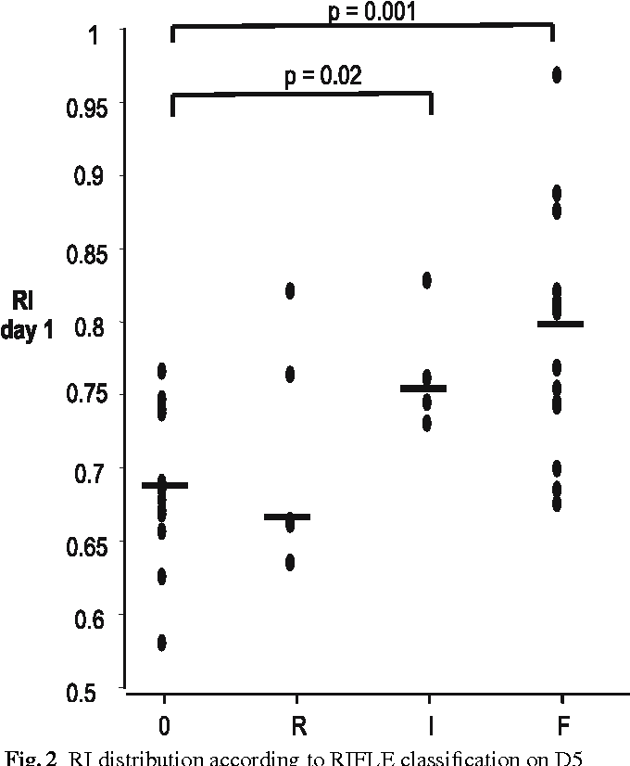
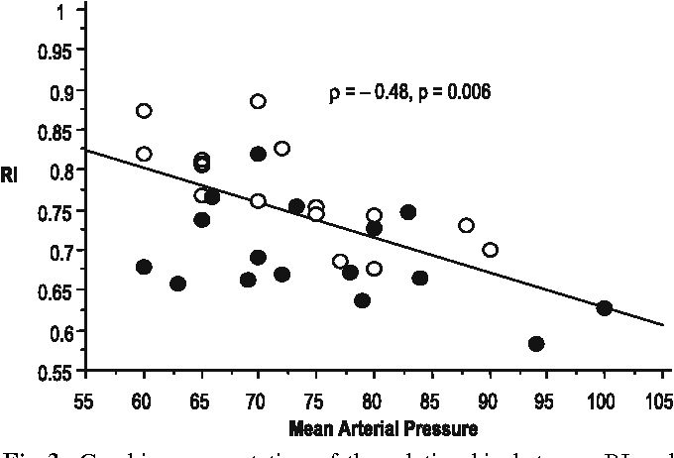
RRI and prediction of AKI in sepsis
In patients admitted to the ICU with sepsis (no prior renal disease), RRI predicts renal injury (Lerolle, 2006)
  RI inversely correlated with MAP

Slide 20
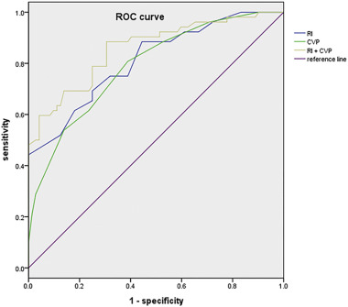
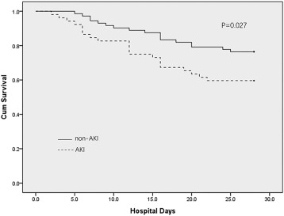
RRI and prediction of AKI in sepsis
RRI and CVP both predict AKI in sepsis
  The combination of RRI and CVP best predict AKI in sepsis
    (Song, 2018)
AUCs
CVP 0.78
RRI 0.81
CVP+RRI 0.86
Kaplan-Meier curve

Slide 21
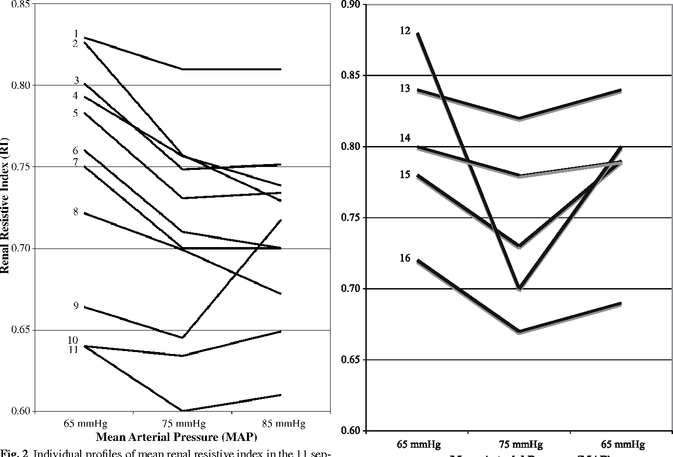
Effect of blood pressure increase and RRI
Increasing MAP was associated with decreases in RRI as well as improvement in urine output
  (Deruddre, 2007)

Slide 22
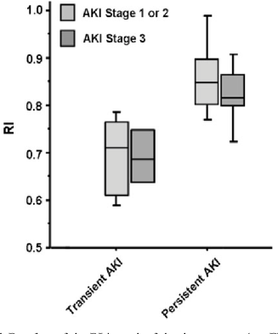
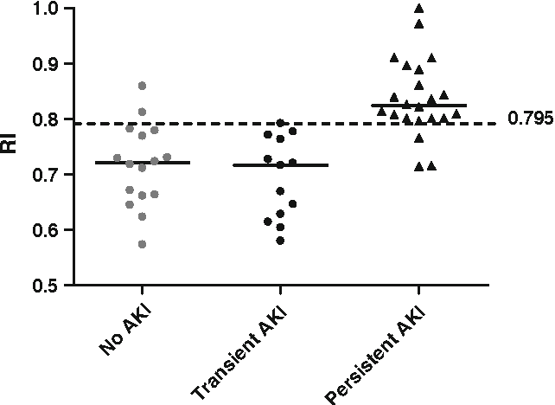
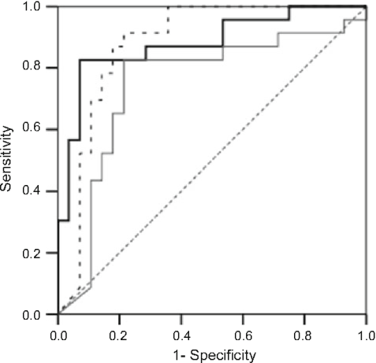
RRI and the reversibility of AKI
In ventilated septic patients a RRI of >0.795 predicted persistent AKI as opposed to no AKI or transient AKI.
  (Darmon, 2011)
RRI vs other renal indices, AUC = 0.91

Slide 23
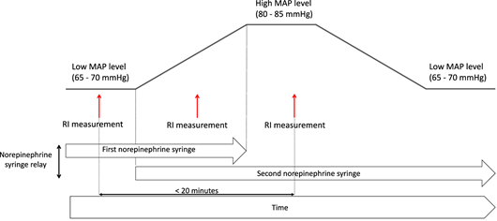
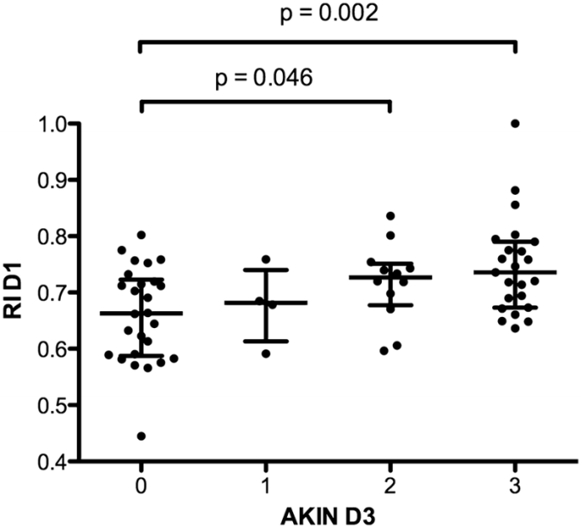
RRI and prediction of AKI
Increased RRI is again associated with severe AKI
Increase in MAP with a decrease in RRI associated with a recovery from RRI
  (Beloncle, 2019)

Slide 24
A case
YOM sepsis from PNA
HR140 bmp, MAP 85 mmHg. Sats 80% on O2.
POCUS:
  Heart displaced to the right (unable to Doppler)
  Lung: Left-lung sliding and areas of scattered B and C profile, mostly sliding A profile. Right-Small effusion and C profile with air-bronchograms.
  IVC: flat
Continuous cardiac monitoring device placed due to inadequate cardiac Doppler angles. NE gtt started at 5 mcg/min and increased to 10 mcg/min
  CO 12.5, SVR 550, MAP 85, HR 130

Slide 25
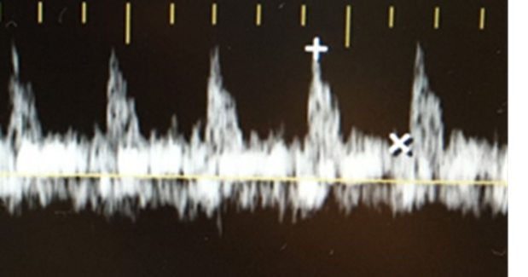
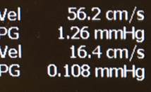


Slide 26
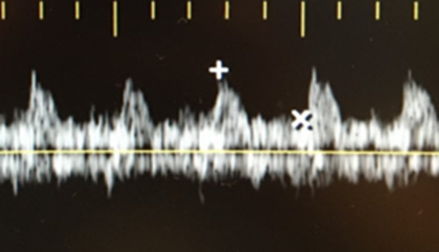
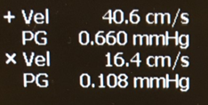

A Case
Additional increases in NE did not change the RRI
Vasopressin started at 0.04 and NE taken back to 10 mcg/min
  HR 115 bpm, MAP 85 mmHg, CO 8.9 L/min, SVR 780, RRI=0.60
    Compare to : CO 12.5, SVR 550, HR 130 bpm, MAP 85 (on NE alone). Recall, started at HR 140, MAP 85

Slide 27
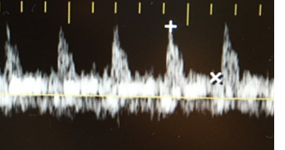

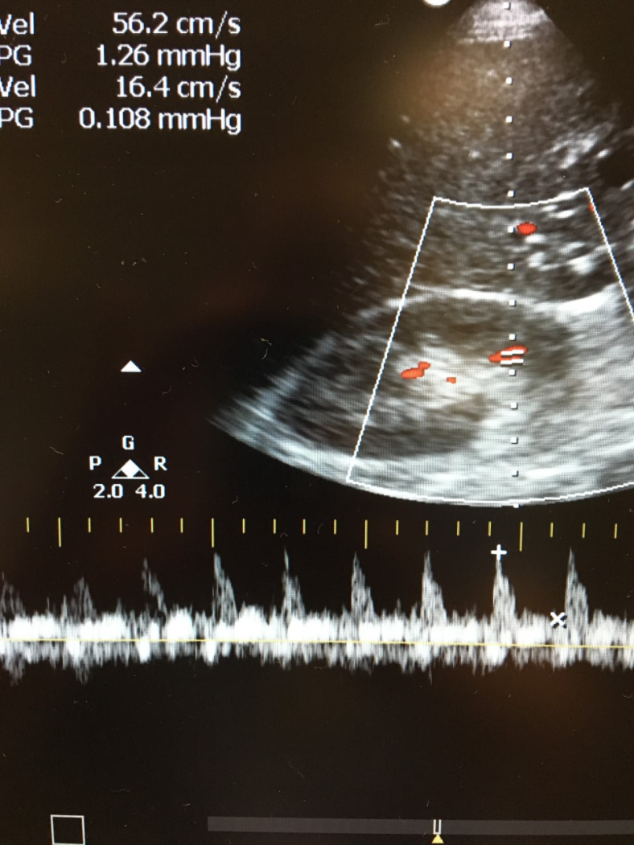
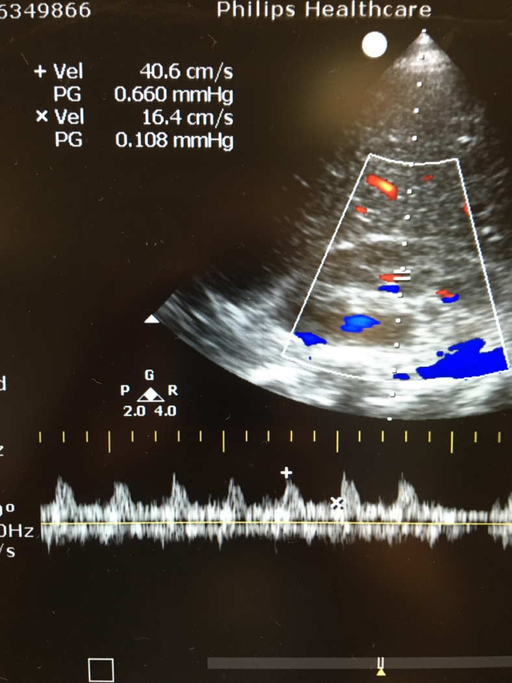
Before and After
RRI=0.71
RRI=0.60

Slide 28
7/3/18

Slide 29
Summary
The intrarenal Doppler pattern consists of both arterial and venous waveforms
Venous waveforms are more straight forward and trend with clinical venous congestion
The RRI is multifactorial and more complex to interpret
  Systemic versus local factors
  Prognostic for AKI and possibly other important outcomes
  A guide to resuscitation?

Slide 30
References
Beloncle et al., Determinants of Doppler-based renal resistive index in patients with septic shock: impact of hemodynamic parameters, acute kidney injury and predisposing factors. Ann Intensive Care. 2019 Apr 24;9(1):51.
Corradi et al., Hemorrhagic shock in polytrauma patients: early detection with renal Doppler resistive index measurements. Radiology. 2011 Jul;260(1):112-8
Darmon et al., Diagnostic accuracy of Doppler renal resistive index for reversibility of acute kidney injury in critically ill patients. Intensive Care Med. 2011 Jan;37(1):68-76.
Deruddre et al., Renal arterial resistance in septic shock: effects of increasing mean arterial pressure with norepinephrine on the renal resistive index assessed with Doppler ultrasonography. Intensive Care Med. 2007 Sep;33(9):1557-62.
Lerolle et al., Renal failure in septic shock: predictive value of Doppler-based renal arterial resistive index. Intensive Care Med. 2006 Oct;32(10):1553-9.
Lido et al., Clinical Implications of Intrarenal Hemodynamic Evaluation by Doppler Ultrasonography in Heart Failure. JACC Heart Failure. Volume 4, issue 8, August 2016, Pages 674-682
Nicolo et al., Renal intraparenchymal resistive index: the ultrasonographic answer to many clinical questions. J Nephrol. 2018 Dec 11
O’Neill, WC. Renal resistive index: a case of mistaken identity. Hypertension. 2014 Nov;64(5):915-7
Song et al., Value of the combination of renal resistance index and central venous pressure in the early prediction of sepsis-induced acute kidney injury. J Crit Care. 2018 Jun;45:204-208
Tang et al., Intrarenal Venous Flow: A Window Into the Congestive Kidney Failure Phenotype of Heart Failure? JACC Heart Fail. 2016 Aug;4(8):683-6

