Slide 1

IVC Collapse Physiology knowing the caveats & evidence
Jon-Emile S. Kenny MD
Senior contributor pulmccm.org
Author of ICU Physiology in 1000 Word Series
Creator heart-lung.org
Cofounder & Chief Medical Officer of Flosonics Medical
Twitter handle @heart_lung

Slide 2
Conflicts of Interest
Chief Medical Officer and Co-founder of
Flosonics Medical in Toronto, Canada

Slide 3
The IVC acts as an un-stressed chamber
Huh?

Slide 4
Vena cava pressure-volume relationship
IVC volume
Spontaneous breathing without assistance
Trans-mural pressure
[CVP – PAB]

Slide 5
Toronto Doppler Monster
RUQ Transverse plane
01/27/2015
MR: 29205

Slide 6
Vena cava pressure-volume relationship
IVC volume
Trans-mural pressure
[CVP – PAB]

Slide 7
Volume or Flow
Guyton
What are some basic assumptions here?
Venous return curve doesn’t change with inspiration & Starling physiology occurs at atmospheric pressure
Cardiac function doesn’t change
Change in pleural pressure is standardized
P_{pl}
P_{msf}
+5
PRA [mm Hg]

Slide 8
Specificity
What are some basic assumptions here?
Volume or Flow
Venous return curve doesn’t change with inspiration & Starling physiology occurs at atmospheric pressure
Cardiac function doesn’t change
P_{crit}
Clinical relevance?
False positive = lower specificity
P_{pl}
P_{msf}
+5
PRA [mm Hg]

Slide 9
90
80
70
60
Specificity
50
40
30
20
10
Notes:
Blue – preau
Red-Muller
Green- Airpetian
Yellow-corl 2017

Slide 10
Sensitivity
What are some basic assumptions here?
Volume or Flow
Change in pleural pressure is standardized
Clinical relevance?
False negative = lower sensitivity
P_{pl}
P_{msf}
+5
PRA [mm Hg]

Slide 11
Based on the above, how could one improve specificity & sensitivity of IVC collapse for determining volume responsiveness?
Exclude patients receiving ventilation assistance
Ensure adequate inspiratory effort

Slide 12
90
80
70
60
50
40
30
20
10
Notes:
Blue – preau
Red-Muller
Green- Airpetian
Yellow-corl 2017

Slide 13
Thank you!
www.heart-lung.org
Stay hungry. Stay Foolish

Slide 14
Advanced Doppler Theory for the intensivist
Jon-Emile S. Kenny MD
Senior contributor pulmccm.org
Author of ICU Physiology in 1000 Word Series
Creator heart-lung.org
Cofounder & Chief Medical Officer of Flosonics Medical
Twitter handle @heart_lung

Slide 15
Conflicts of Interest
Chief Medical Officer and Co-founder of
Flosonics Medical in Toronto, Canada

Slide 16
Background: Doppler & velocity

Slide 17
Toronto Doppler Monster
Suprasternal Notch
01/27/2015
MR: 29205
80
60
40
20
cm/s

Slide 18




Doppler Equation
$$transmit (ft)$$
$$receive (fr)$$
$$=\frac{2ft ⦁ v (\cos{Ɵ})}{c}$$
$$fr−ft$$

Slide 19



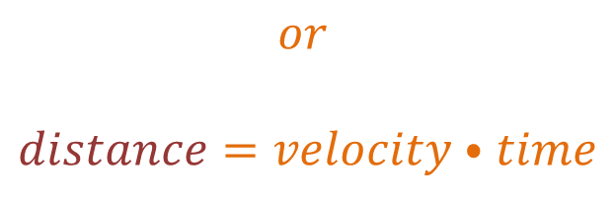
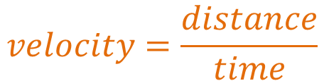
Velocity & Time At the Bedside
So what?
$$velocity=\frac{distance}{time}$$
$$velocity$$
$$or$$
$$distance=velocity ⦁ time$$
$$distance$$
$$time$$

Slide 20




Velocity Time Integral = Distance
So what?
$$volume=area ⦁ length$$
$$radius$$
$$A=πr^{2}$$
$$distance (length)$$

Slide 21







Continuous Wave & Pulsed Wave
$$transmit$$
$$receive$$
$$transmit \& receive$$
$$velocity$$
$$velocity$$
$$time$$
$$time$$

Slide 22
Velocity Error: intrinsic aspects

Slide 23



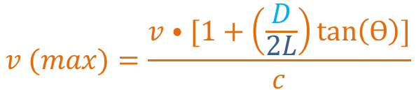


Geometric Spectral Broadening
$$linear array transducer$$
$$L$$
$$smaller \left(sharper\right) angle$$
Ɵ
$$v (max)=\frac{v ⦁ [1+\left(\frac{D}{2L}\right)\tan\left(Ɵ\right)]}{c}$$
$$velocity$$
Oh no! why?!
$$time$$

Slide 24






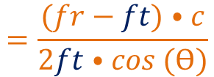

Cosine Error
Cosine Error
$$y=\cos{(x)}$$
$$1.0$$
$$0.5$$
$$45o$$
$$90o$$
$$angle of insonation$$
$$=\frac{(fr−ft) ⦁ c}{2ft ⦁ cos (Ɵ)}$$
$$v$$

Slide 25
Velocity Error: extrinsic aspects

Slide 26


Velocity Time Integral = Distance
What is the assumption here?
$$PW Doppler system$$
$$velocity$$
$$time$$
$$Does the VTI here$$
$$represent the true$$
$$distance?$$
$$distance (length)$$

Slide 27
Velocity Gradient Broadening
$$plug flow$$
$$(aortic root, LVOT)$$
$laminar flo$w
$$(peripheral arteries)$$
$$how do we measure volume \& flow in a peripheral artery?$$

Slide 28



Accounting for Velocity Gradient Broadening
$$flow=area x$$
$$Vmean$$
$$Plug$$
$$Laminar$$
$$velocity$$
$$velocity$$
$$time$$
$$time$$
$$amplitude$$
$$amplitude$$

Slide 29
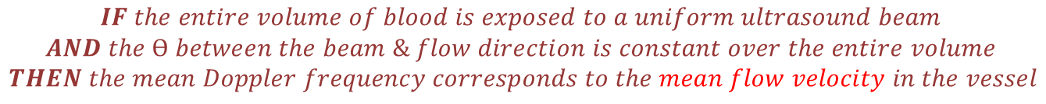

Uniform Insonation
$$CW system$$
$$CW system$$
$$PW Doppler system$$
$$IF the entire volume of blood is exposed to a uniform ultrasound beam$$
$$AND the Ɵ between the beam \& flow direction is constant over the entire volume$$
$$THEN the mean Doppler frequency corresponds to the mean flow velocity in the vessel$$

Slide 30
Area

Slide 31
























$$80\%$$
$$70\%$$
$$60\%$$
$$50\%$$
$$flow error$$
$$40\%$$
$$diameter error$$
$$30\%$$
$$+1.5 mm$$
$$20\%$$
$$+1.0 mm$$
$$10\%$$
$+$0$.5 mm$
$+$0$.2 mm$
$$0$$
$$1$$
$$2$$
$$3$$
$$4$$
$$5$$
$$6$$
$$7$$
$$8$$
$$9$$
$$vessel diameter (mm)$$

Slide 32

In Review …
$$flow=area ⦁ Vmean$$
Inherent variability at high angles of insonation
Inherent variability with linear array transducers
Velocity profiles pose sampling problems with PW
Small errors in measurement leads to large error in flow
Assumes constant circular shape
Small errors in diameter may be due to inherent ultrasound characteristics

Slide 33
Thank you!
www.heart-lung.org
Stay hungry. Stay Foolish

