Slide 1




Contrast nephropathy ?
An update
Judy Morris, MD, FRCPC, MSc
Department of Emergency Medicine
Hôpital du Sacré-Cœur de Montréal
Associate professor
Université de Montréal

Slide 2
Contrast nephropathy ?
An update
Radiologic Contrast :
Is it nephrotoxic?

Slide 3
Conflicts of interests….
Local Investigator for RAFF-3
Canet received $ from pharmaceuticals

Slide 4
Objectives
Definitions
What’s known
What’s new
Advice for patient care

Slide 5

Contrast-
Induced
Nephropathy?

Slide 6
Increase in creatinine…
1. … 25 % vs. base value
2. …..50 % vs. base value
3. …..75 % vs. base value
4. ….100% vs. base value

Slide 7
Increase in creatinine…
1. …de 25 % vs. base value
72 hr after contrast
Return to N = 7 days
2. ….. 50 % vs. base value
3. ……75 % vs. base value
4. ……100% vs. base value

Slide 8
Acute
Kidney
Injury

Slide 9
Increase in creatinine…
1. … 25 % vs. base value
2. …..50 % vs. base value
3. …..75 % vs. base value
4. ….100% vs. base value

Slide 10

Increase in creatinine…
1. ….. 25 % vs. base value
2. …50 % vs. base value
3. ….. 75 % vs. base value
4. …… 100% vs. base value

Slide 11

Contrast nephropathy

Slide 12
Contrast nephropathy:
Δ 25 % creatinine
1980 – 2000
++ studies in elective population
Different practices :
contrast
prevention

Slide 13
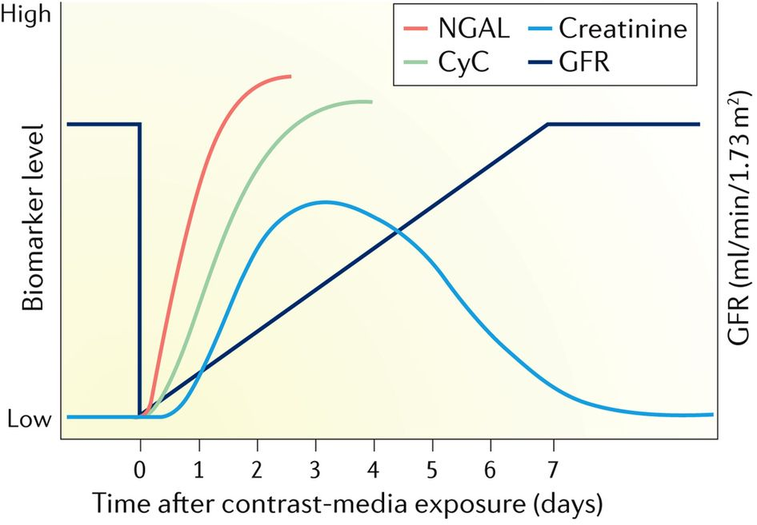
Contrast patients
No control group

Slide 14

Non
Contrast patients
No control group

Slide 15
Contrast nephropathy:
Δ 25 % creatinine
Clinical endpoints?
Rare
If comorbidities
Long term effects ?
Dialysis risk ?
Association or cause ?

Slide 16
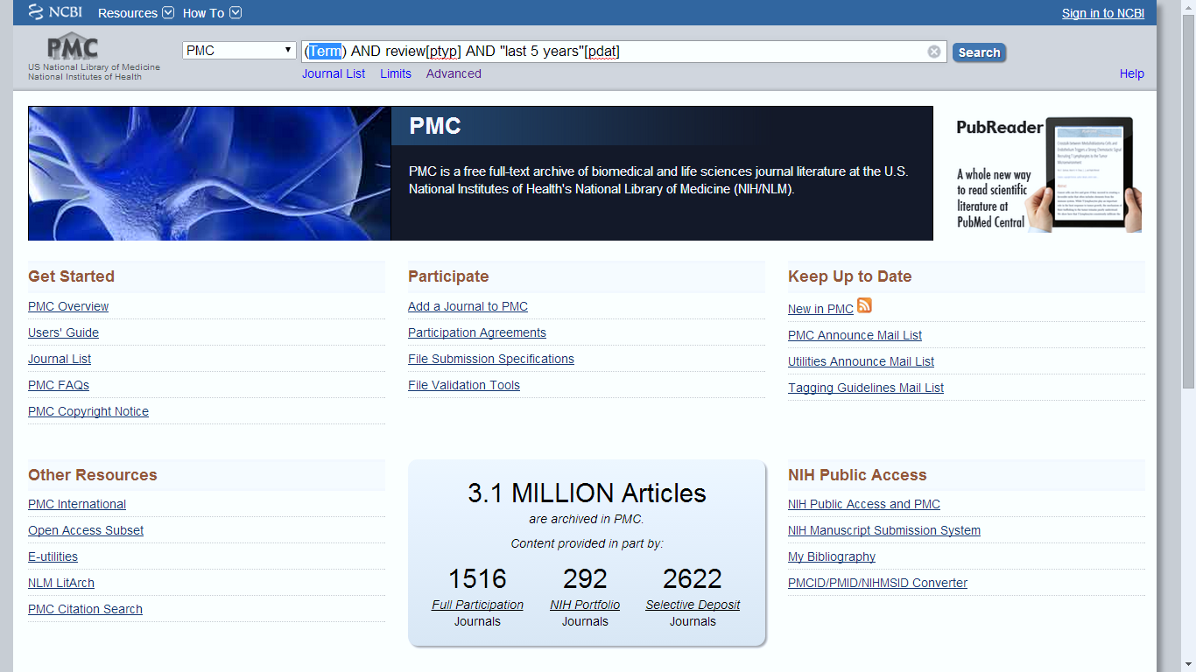
What’s new ?

Slide 17
What’s new
Contrast-Induced
Nephropathy
Δ 25%
Articles ++

Slide 18
What’s new
Contrast-Induced
Nephropathy?
Δ 25%

Slide 19
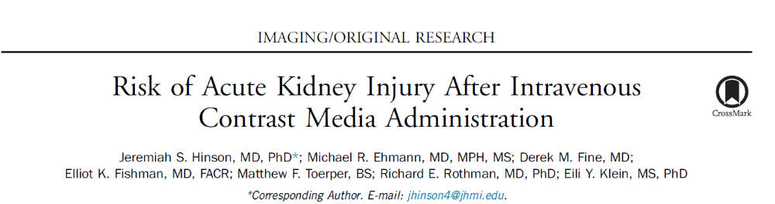
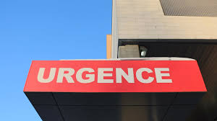
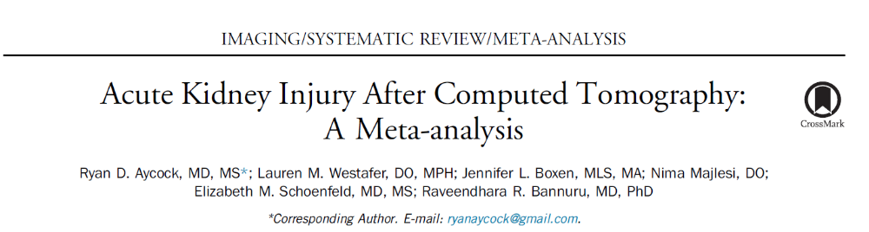
Annals of emergency medicine, May 2017
Annals of emergency medicine, Jan 2018

Slide 20
Endpoints
1.Acute kidney injury
2.Need for dialysis
3.Mortality

Slide 21
Retrospective studies
> 100 000 patients
Control groups
Patients without CT
Patients with CT C-

Slide 22

What’s new
Propensity analysis

Slide 23
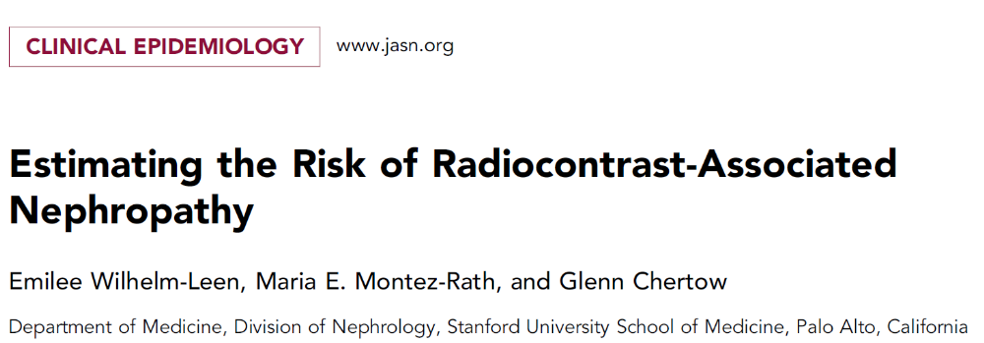
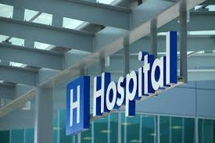
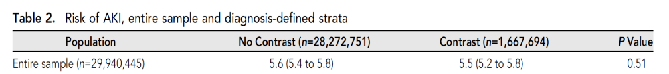
Journal of American Society of Nephrology, Feb 2017

Slide 24
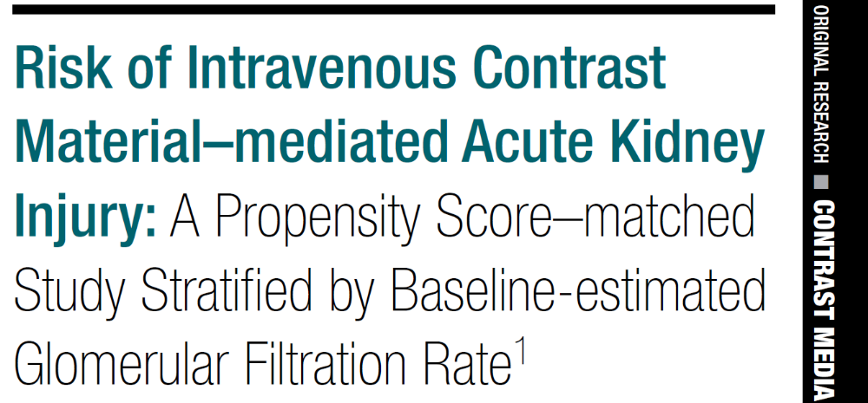
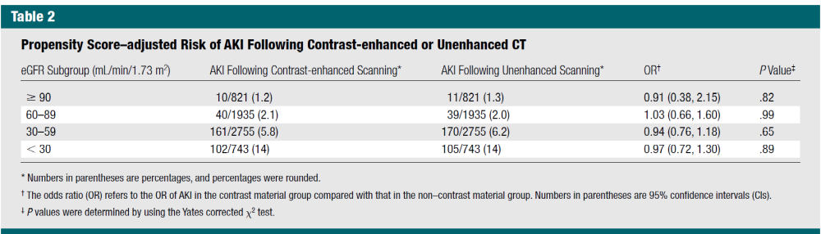
Radiology, April 2014

Slide 25
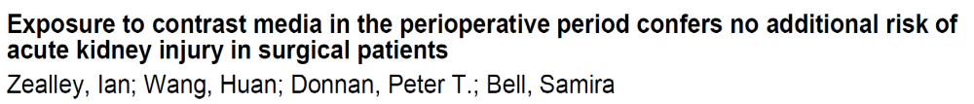
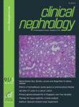
Nephrology Dialysis Transplantation, October 2018
Rate and risk factors for AKI after CT scans in a cancer cohort
Sheron Latcha^{1, 4}, Andrew J. Plodkowski², Junting Zheng³, Edgar A. Jaimes^{1, 41} Renal Service, ² Department of Radiology, ³ Epidemiology, Biostatistics, Memorial Sloan Kettering Cancer Center, ⁴ Weill Cornell Medical College, New York, NY, USA
Clinical Nephrology, March 2019

Slide 26
Results
No increased risk of AKI with contrast
Other Risk Factors identified for AKI

Slide 27


Contrast-induced nephropathy ….

Slide 28
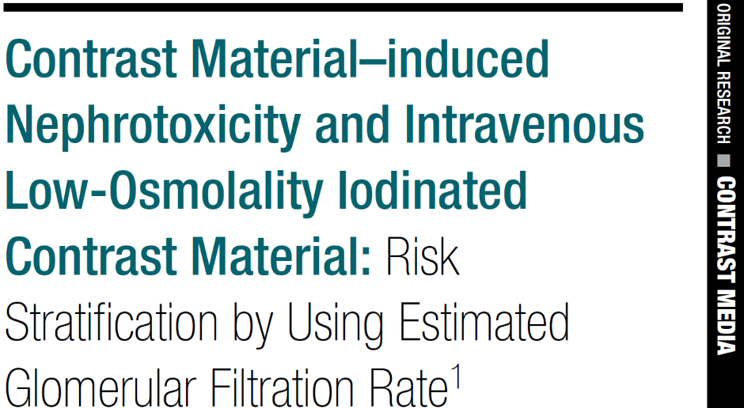
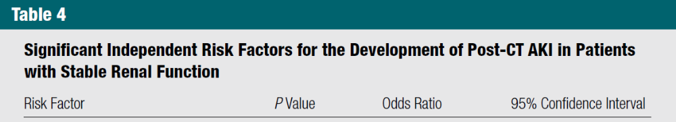
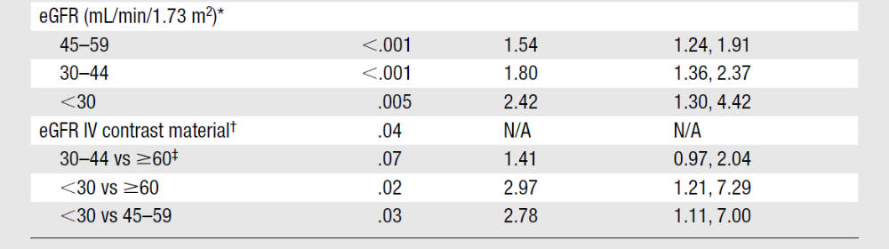
Radiology, September 2013
(renal function as a factor alone)

Slide 29
What’s new
Clinical outcomes?
Also…….
Retrospective studies
Protection from hydration?
Less contrast exposure for sicker patients ?

Slide 30
What’s new
Clinical outcomes?
In summary….
Possible risk
Especially in sicker patients
NO Randomized controlled studies
Actual practise is safe ?

Slide 31
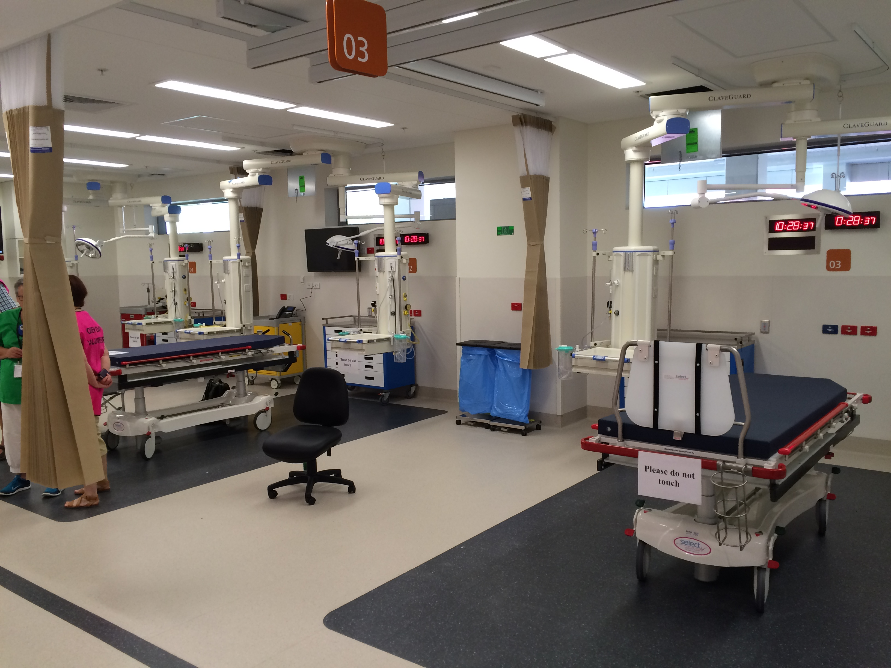
Advice for patient care ?

Slide 32
Consider
Risk factors of AKI:
Age > 75 y.o
Comorbidities
Hypovolemia
Medications
Volume of contrast
Intra-arterial

Slide 33
Consider
Checking renal function
ClCr : < 60 ml/min
ClCr : > 60 ml/min

Slide 34
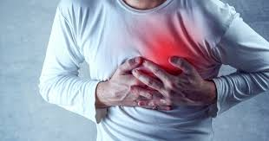

Slide 35
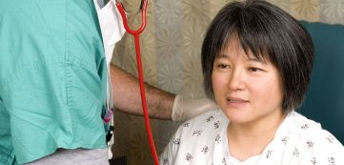

Slide 36

Renal function before study
ClCr : > 60 ml/min

Slide 37
Renal function before study
ClCr : < 60 ml/min

Slide 38

Consider
Alternative study without contrast?

Slide 39
Consider
Optimal hydration
Especially if decreased GFR
No agent proven better
Avoid dehydration – hypovolemia (pre-renal insult)

Slide 40
Consider
Avoid – Stop
Medications that are potentially nephrotoxic

Slide 41
Consider
Discuss with radiologist
Quantity of contrast ?
Type of contrast?

Slide 42

Consider

Slide 43



Guidelines

Slide 44
In summary ..
Recent contrast agents : less dangerous than we thought
CIN ≠ AKI
CIN ≠ significant clinical outcomes
Uncertainty in patients with:
- abnormal renal function
- other renal insults
Current practice has protective effect

Slide 45

When reading on contrast injury…..
AKI : Acute kidney injury
Control group
Clinical endpoints
Your patients

Slide 46
Merci …..
?

Slide 47
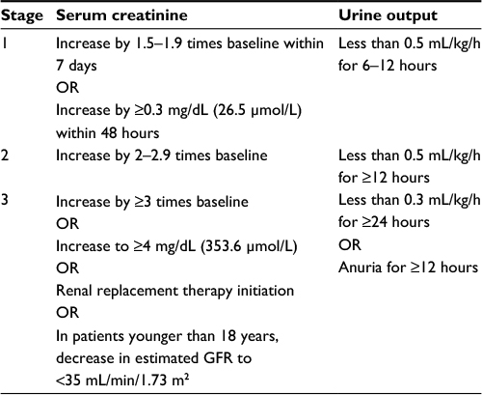
Acute Kidney Injury – KDIGO - 2012

Slide 48
Medications to discontinue
Medications to discontinue (before study & 48 hrs post study)
Non steroidal anti-inflammatories | Other agents to consider d-c
Diuretics | Aminoglycosides
Angiotensin receptor blockers | Antihypertensives
Metformin | Angiotensin II receptor blockers

Slide 49
References :
1: Aycock RD, Westafer LM, Boxen JL, Majlesi N, Schoenfeld EM, Bannuru RR. Acute Kidney Injury After Computed Tomography: A Meta-analysis. Ann Emerg Med. 2018 Jan;71(1):44-53.e4. doi: 10.1016/j.annemergmed.2017.06.041. Epub 2017 Aug 12. Review. PubMed PMID: 28811122.
2: Pavlov I. Hydration and contrast-induced kidney injury. Lancet. 2017 Jul 29;390(10093):453. doi: 10.1016/S0140-6736(17)31811-1. Epub 2017 Jul 27. PubMed PMID: 28792407.
3: Hinson JS, Ehmann MR, Fine DM, Fishman EK, Toerper MF, Rothman RE, Klein EY. Risk of Acute Kidney Injury After Intravenous Contrast Media Administration. Ann Emerg Med. 2017 May;69(5):577-586.e4. doi: 10.1016/j.annemergmed.2016.11.021.Epub 2017 Jan 25. PubMed PMID: 28131489.
4: Heller M, Krieger P, Finefrock D, Nguyen T, Akhtar S. Contrast CT Scans in the Emergency Department Do Not Increase Risk of Adverse Renal Outcomes. West J Emerg Med. 2016 Jul;17(4):404-8. doi: 10.5811/westjem.2016.4.28994. Epub 2016 Jun 29. PubMed PMID: 27429690; PubMed Central PMCID: PMC4944796.
5: Chalikias G, Drosos I, Tziakas DN. Contrast-Induced Acute Kidney Injury: An Update. Cardiovasc Drugs Ther. 2016 Apr;30(2):215-28. doi:10.1007/s10557-015-6635-0. Review. PubMed PMID: 26780748.
6: Nicola R, Shaqdan KW, Aran K, Mansouri M, Singh A, Abujudeh HH. Contrast-Induced Nephropathy: Identifying the Risks, Choosing the Right Agent,and Reviewing Effective Prevention and Management Methods. Curr Probl DiagnRadiol. 2015 Nov-Dec;44(6):501-4. doi: 10.1067/j.cpradiol.2015.04.002. Epub 2015 Apr 15. Review. PubMed PMID: 26072134.
7: Sonhaye L, Kolou B, Tchaou M, Amadou A, Assih K, N'Timon B, Adambounou K,Agoda-Koussema L, Adjenou K, N'Dakena K. Intravenous Contrast Medium Administration for Computed Tomography Scan in Emergency: A Possible Cause of Contrast-Induced Nephropathy. Radiol Res Pract. 2015;2015:805786. doi:10.1155/2015/805786. Epub 2015 Oct 20. PubMed PMID: 26576300; PubMed Central PMCID: PMC4630667.
8: Abe M, Morimoto T, Akao M, Furukawa Y, Nakagawa Y, Shizuta S, Ehara N,Taniguchi R, Doi T, Nishiyama K, Ozasa N, Saito N, Hoshino K, Mitsuoka H, Toma M,Tamura T, Haruna Y, Kita T, Kimura T. Relation of contrast-induced nephropathy tolong-term mortality after percutaneous coronary intervention. Am J Cardiol. 2014 Aug 1;114(3):362-8. doi: 10.1016/j.amjcard.2014.05.009. Epub 2014 May 16. PubMed PMID: 24927973.
11: Hassen GW, Hwang A, Liu LL, Mualim F, Sembo T, Tu TJ, Wei DH, Johnston P, Costea A, Meletiche C, Usmani S, Barber A, Jaiswal R, Kalantari H. Follow up for emergency department patients after intravenous contrast and risk of nephropathy.West J Emerg Med. 2014 May;15(3):276-81. doi: 10.5811/westjem.2013.8.17915. Epub 2014 Jan 7. PubMed PMID: 24868304; PubMed Central PMCID: PMC4025523.
12: Andreucci M, Solomon R, Tasanarong A. Side effects of radiographic contrast media: pathogenesis, risk factors, and prevention. Biomed Res Int.2014;2014:741018. doi: 10.1155/2014/741018. Epub 2014 May 11. Review. PubMed PMID: 24895606; PubMed Central PMCID: PMC4034507.
13: Marenzi G, Cabiati A, Milazzo V, Rubino M. Contrast-induced nephropathy.Intern Emerg Med. 2012 Oct;7 Suppl 3:S181-3. doi: 10.1007/s11739-012-0803-z.Review. PubMed PMID: 23073854.

Slide 50
References :
14.: Latcha S, Plodkowski AJ, Zheng J, Jaimes EA. Rate and risk factors for AKI after CT scans in a cancer cohort . Clin Nephrol. 2019 Mar;91(3):147-154. doi:10.5414/CN109591. PubMed PMID: 30415653.
15: Hinson JS, Al Jalbout N, Ehmann MR, Klein EY. Acute kidney injury following contrast media administration in the septic patient: A retrospective propensity-matched analysis. J Crit Care. 2019 Feb 4;51:111-116. doi: 10.1016/j.jcrc.2019.02.003. [Epub ahead of print] PubMed PMID: 30798098.
16: Jiang W, Yu J, Xu J, Shen B, Wang Y, Luo Z, Wang C, Ding X, Teng J. Impact of cardiac catheterization timing and contrast media dose on acute kidney injury after cardiac surgery. BMC Cardiovasc Disord. 2018 Oct 5;18(1):191. doi: 10.1186/s12872-018-0928-8. PubMed PMID: 30290766; PubMed Central PMCID:PMC6173877.
17: Dekkers IA, van der Molen AJ. Propensity Score Matching as a Substitute for Randomized Controlled Trials on Acute Kidney Injury After Contrast Media Administration: A Systematic Review. AJR Am J Roentgenol. 2018 Oct;211(4):822-826. doi: 10.2214/AJR.17.19499. Epub 2018 Aug 7. PubMed PMID:30085838.
18: Zealley I, Wang H, Donnan PT, Bell S. Exposure to contrast media in the perioperative period confers no additional risk of acute kidney injury in surgical patients. Nephrol Dial Transplant. 2018 Oct 1;33(10):1751-1756. doi: 10.1093/ndt/gfx325. PubMed PMID: 29237046.
19: McDonald RJ, McDonald JS, Carter RE, Hartman RP, Katzberg RW, Kallmes DF, Williamson EE. Intravenous contrast material exposure is not an independent risk factor for dialysis or mortality. Radiology. 2014 Dec;273(3):714-25. doi: 10.1148/radiol.14132418.
20: Davenport MS, Khalatbari S, Cohan RH, Ellis JH. Contrast medium-induced nephrotoxicity risk assessment in adult inpatients: a comparison of serum creatinine level- and estimated glomerular filtration rate-based screening methods. Radiology. 2013 Oct;269(1):92-100. doi: 10.1148/radiol.13122462. Epub 2013 Apr 11. PubMed PMID: 23579047; PubMed Central PMCID: PMC3781354.
21: Davenport MS, Khalatbari S, Cohan RH, Dillman JR, Myles JD, Ellis JH. Contrast material-induced nephrotoxicity and intravenous low-osmolality iodinated contrast material: risk stratification by using estimated glomerular filtration rate. Radiology. 2013 Sep;268(3):719-28. doi: 10.1148/radiol.13122276. Epub 2013 Apr 11. PubMed PMID: 23579046.
22: Wilhelm-Leen E, Montez-Rath ME, Chertow G. Estimating the Risk of Radiocontrast-Associated Nephropathy. J Am Soc Nephrol. 2017 Feb;28(2):653-659. doi: 10.1681/ASN.2016010021. Epub 2016 Sep 29. PubMed PMID: 27688297; PubMed Central PMCID: PMC5280012.

