Slide 1
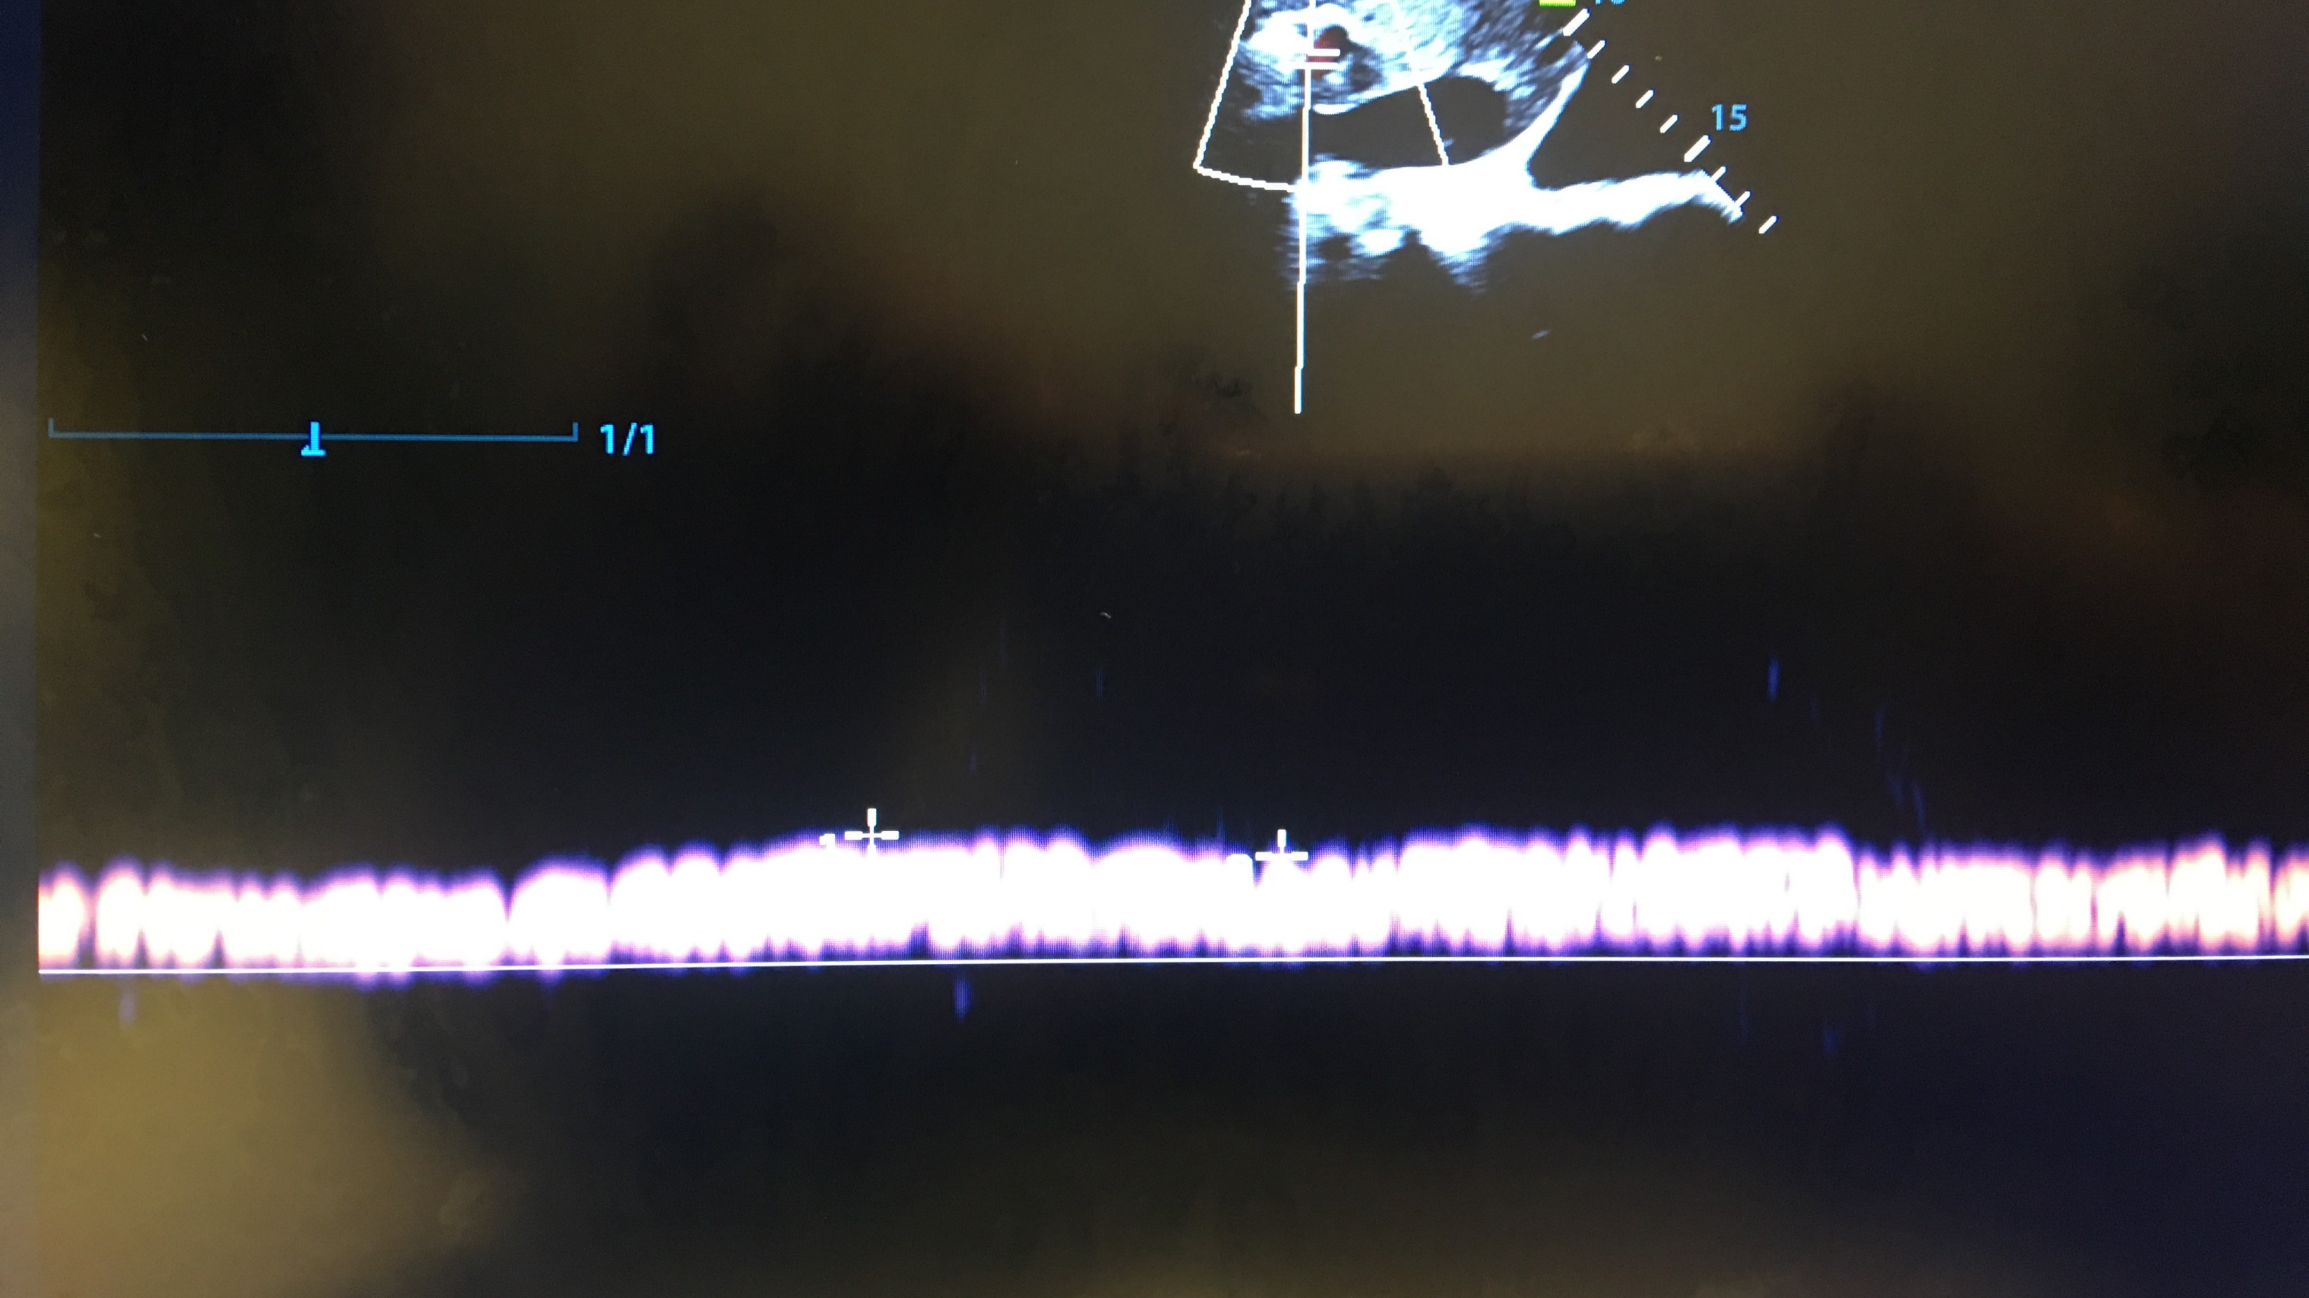
Hypervolemic versus Hypovolemic Hyponatremia: Portal Vein as the Tie Breaker
Sharad Patel
Intensivist/Nephrologist
Cooper University Hospital

Slide 2

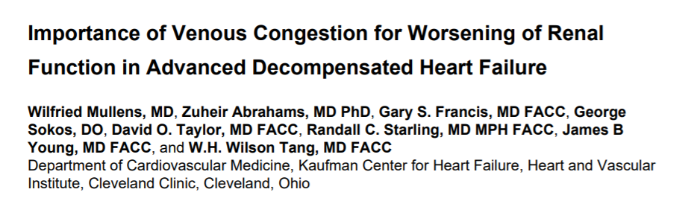
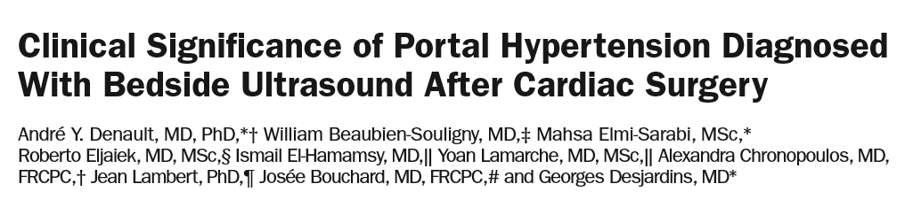
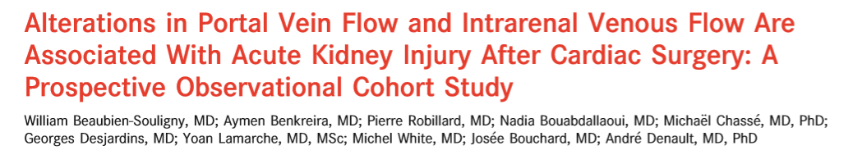

Slide 3
Hyponatremia to AKI
(Na+ K)
TBW
Free water intake
Low CO/Venous Congestion
Hypervolemic hyponatremia
Functional Pre-renal AKI
High RAAS/ADH
Parenchymal AKI
Creatinine Rise

Slide 4
Hyponatremia
Hyponatremia
Hypovolemic
Euvolemic
Hypervolemic
Low effective circulating volume
Low Effective Circulating Volume
High ADH/normal/low RAAS
High ADH/RAAS
High ADH/RAAS
Low urine sodium
Parenchymal AKI
Parenchymal AKI
Low urine sodium
Saline/Fluid
Diuresis

Slide 5

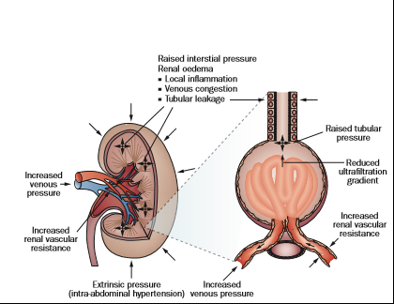



Notes:
AKI----”Give fluids to protect the kidneys” ---remains oliguric----Increase intracapsular pressure leads to increased tubular pressures, therefore the gradient for filtration will be reduced, can maintain aki. Increased intrabdominal pressures, will increase renal venous pressures, decrease rbf, increase RAAS system, increases salt retention.
I will recomplciate the kidney for yu
When fluid overloaded pt receives more fluid, normal filtration happens between cap loops afferent arteriole and bowman’s space pressure. When you give kidney fluid in vol overloaded (with likely renal interstitial edema)—gfr is dropped already…fluid overload will actually annuate gfr further. This is the anti-kidney-as a coffee-filter theory/explanation
I love my coffee. I wish this analogy …I put more water in, I get coffee..I put no water in, I get no coffee and am therefore vvvvvv cranky on rounds

Slide 6
Case
54 y/o male presents to ER via EMS after noted to be PEA arrest, estimated downtime of 20 minutes before ROSC.
  Sodium 115 meq/L (135-145 meq/L)
  Creatinine . 9 mg/dl (79.5 umol/L)
  Urine sodium < 5 meq/L

Slide 7
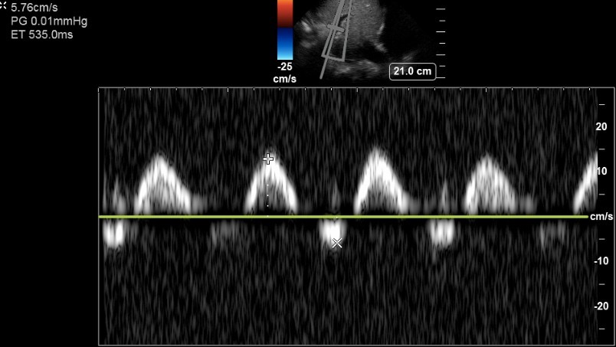
Day 1

Slide 8
Case cont.
Based on the lab and ultrasound findings, a diagnosis of hypervolemic hyponatremia was made. Diuresis was initiated by starting IV furosemide 60 mg every 8 hours with concurrent metolazone 5 mg every 12 hours.
  3.8 liters negative (over 48 hours)
  Sodium 131 meq/L
  Potassium 3.8
  Creatinine-.8 mg/dl (70 umol/L)

Slide 9
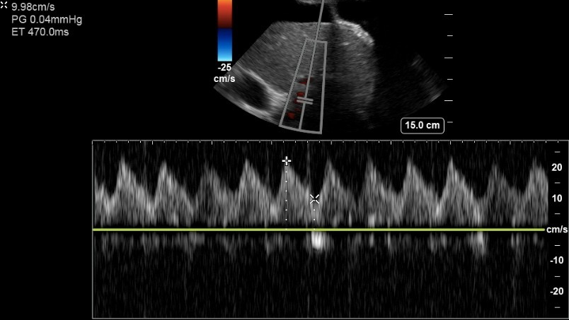
Day 3

Slide 10
Case 2
95-year-old male with a past medical history of heart failure with reduced ejection fraction and atrial fibrillation with presents with dyspnea found to be hypoxic to 85%. NIV started.
  Sodium 120 meq/L
  Potassium 4.9
  Creatinine-1.91

Slide 11
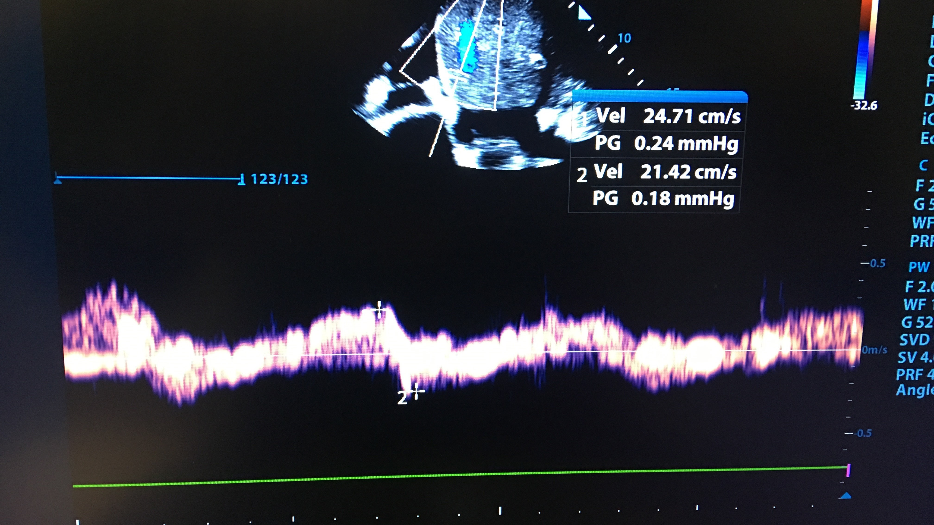
Day 1 Portal Vein

Slide 12
Case 2
Based on his labs and portal vein assessment, diuresis with IV furosemide 80 mg TID and PO metolazone 5 mg bid was initiated.
  Net negative 3.5 liters
  Sodium 136 meq/L
  Potassium 3.9
  Creatinine-1.2 (106 umol/L)

Slide 13

Day 3 Portal Vein

Slide 14
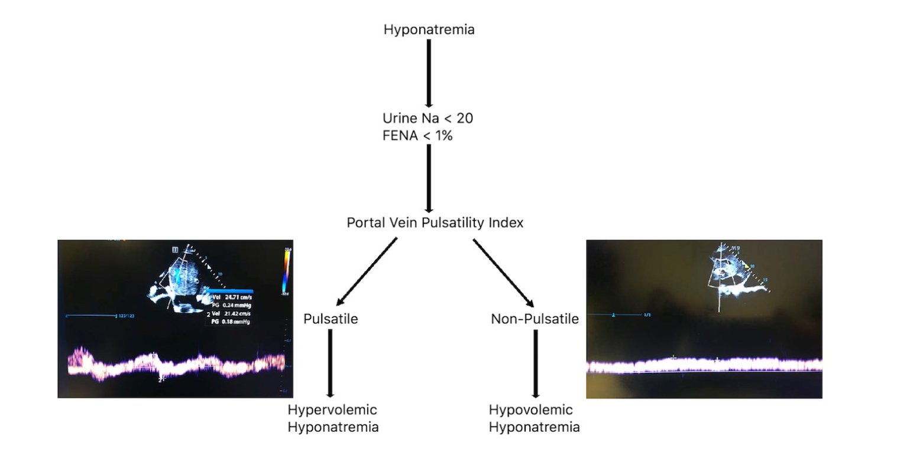

Slide 15
Conclusions
Hypovolemic or Hypervolemic hyponatremia are physiologically similar
Portal vein pulsatility can be used to differentiate Hyper/Hypovolemic mechanisms for hyponatremia
Future application

Slide 16
Patel-sharad@cooperhealth.edu

