Slide 1
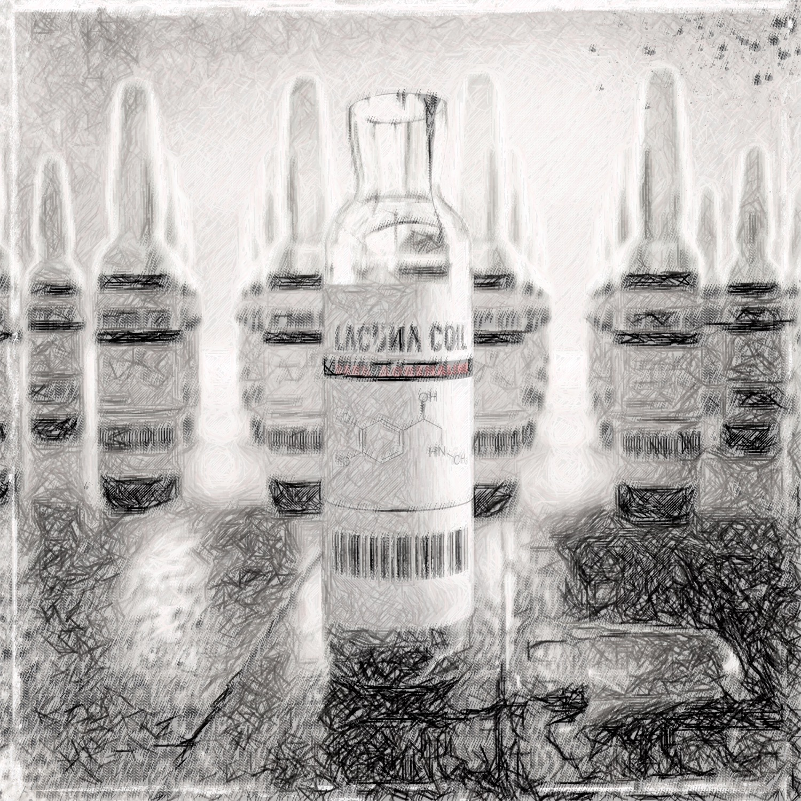
The
Great
Epi
Debate
Rory Spiegel, MD

Slide 2
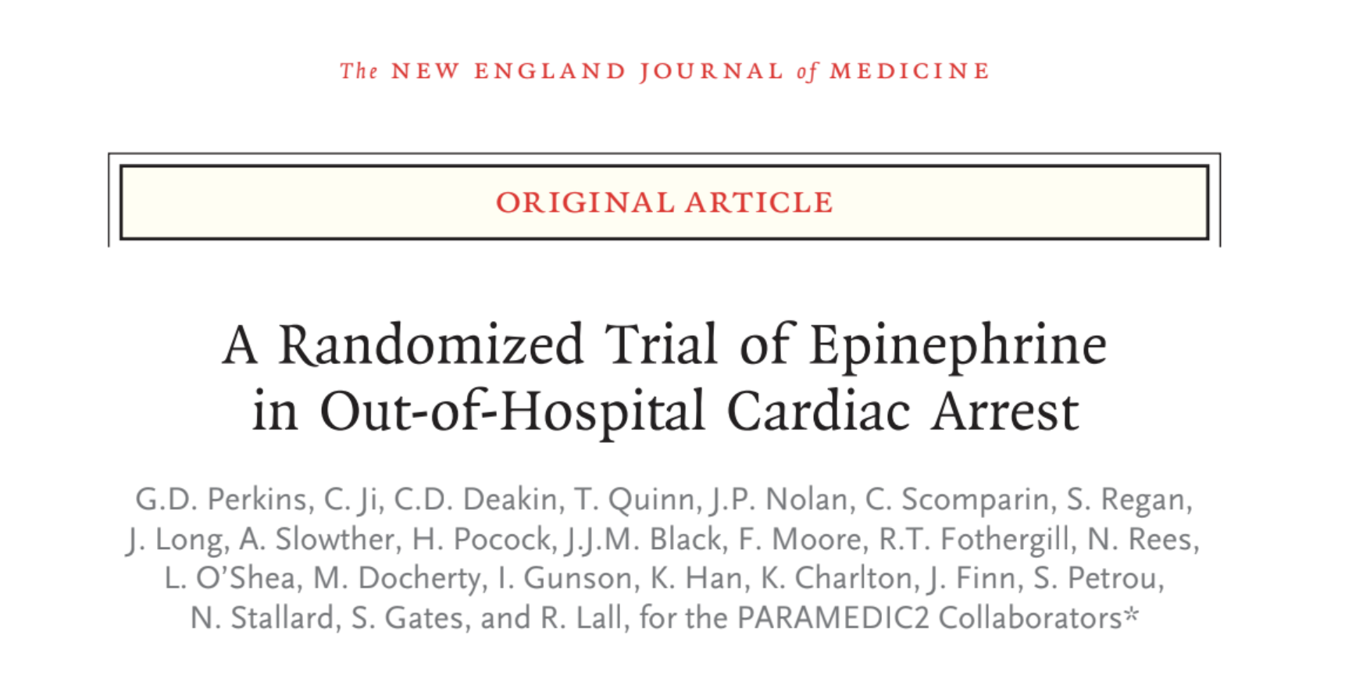

Slide 3
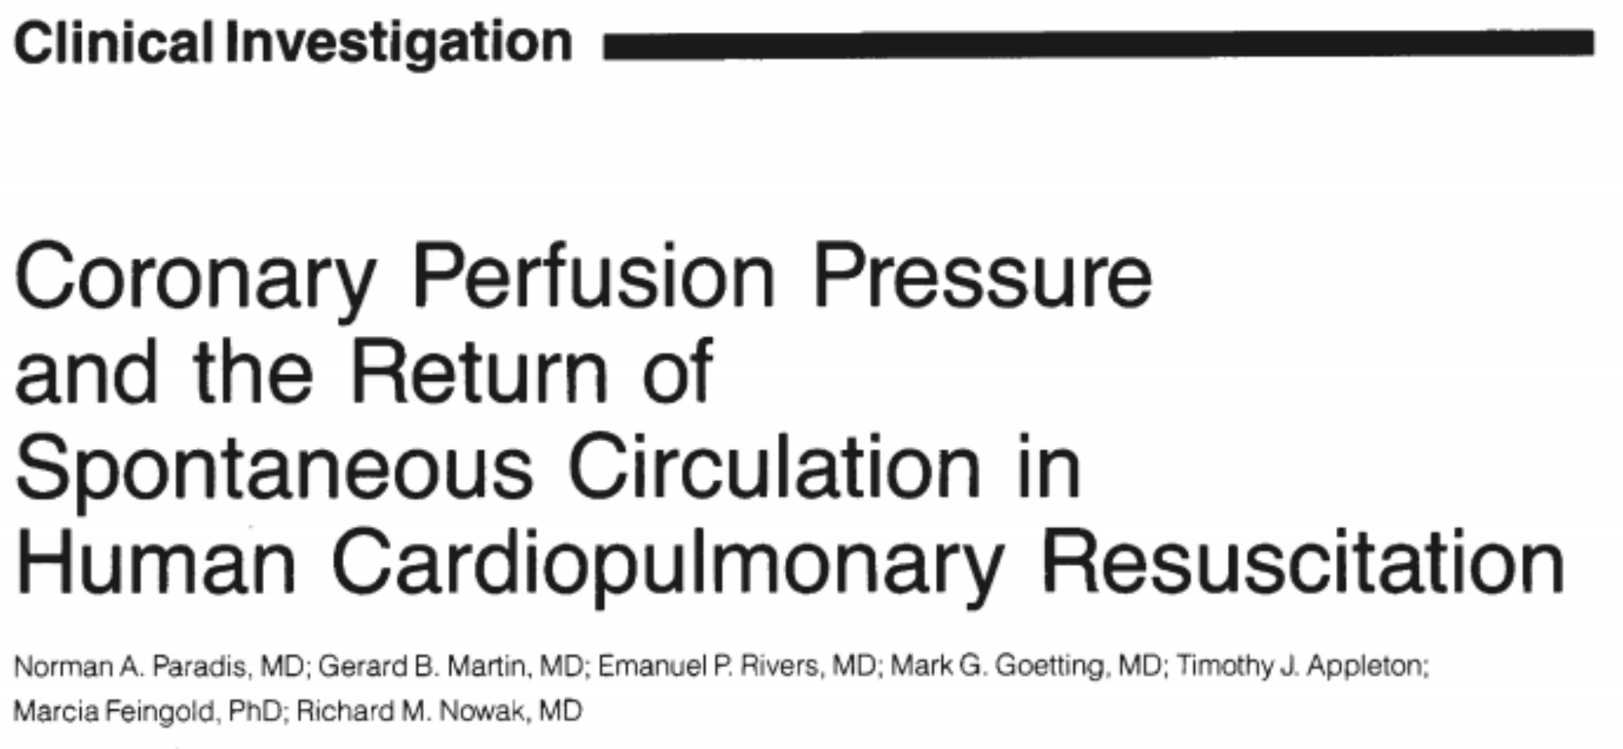
DBP
-RAP
CPP

Slide 4
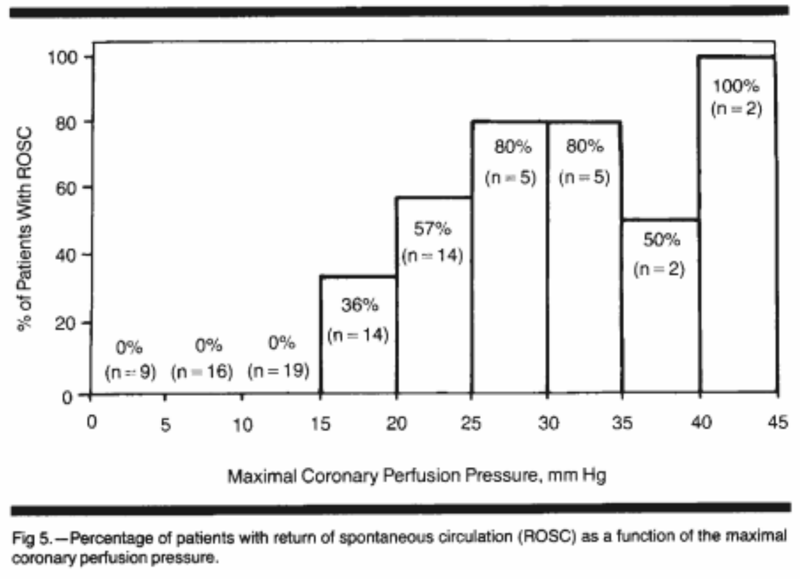
ROSC
CPP

Slide 5

Evidence?
Evidence

Slide 6


Slide 8

2.1%
3.2%
2.4%
1.6%
0.8%

Slide 9
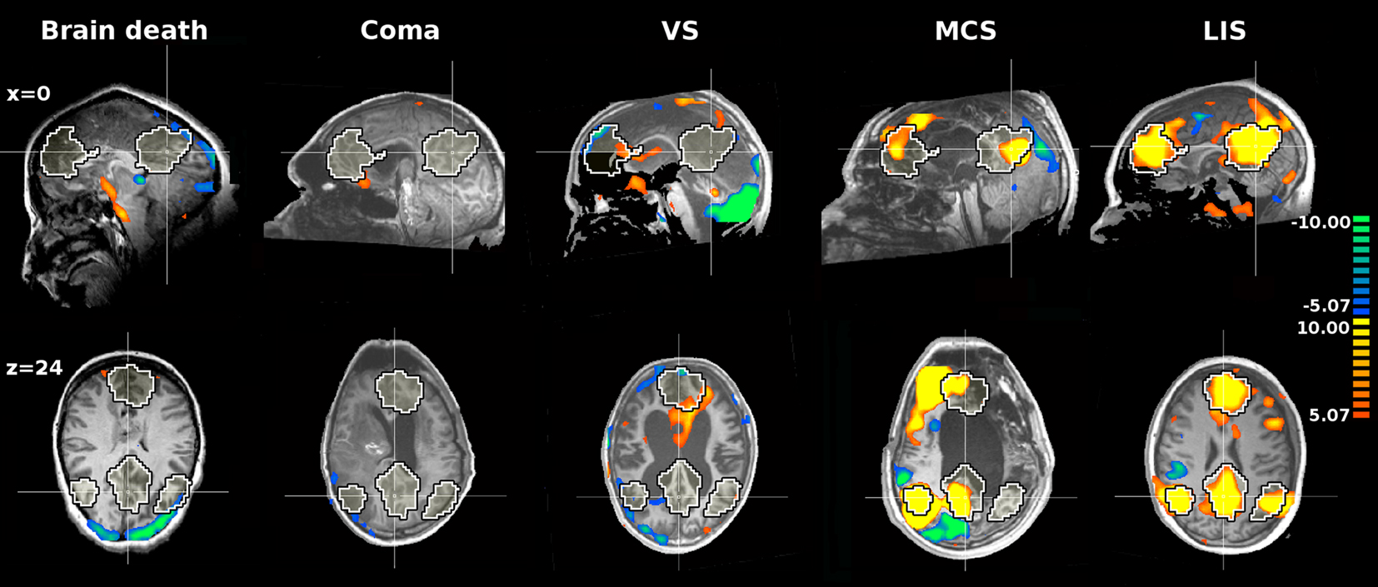

Slide 10
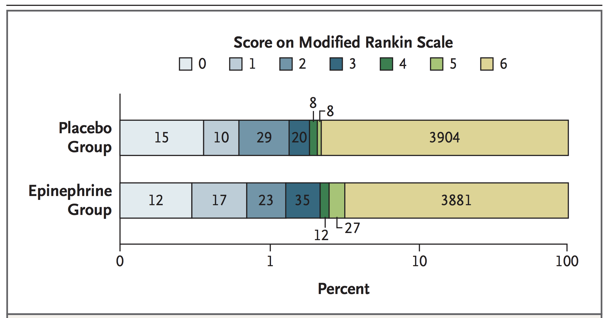

Slide 11
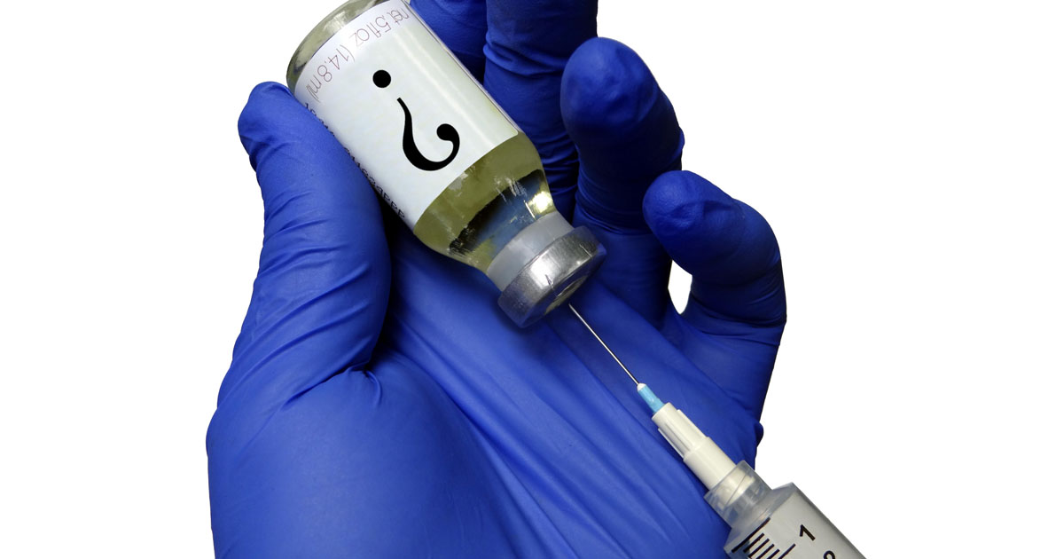

Slide 12

20 Minutes

Slide 13
ROSC
CPP

Slide 14
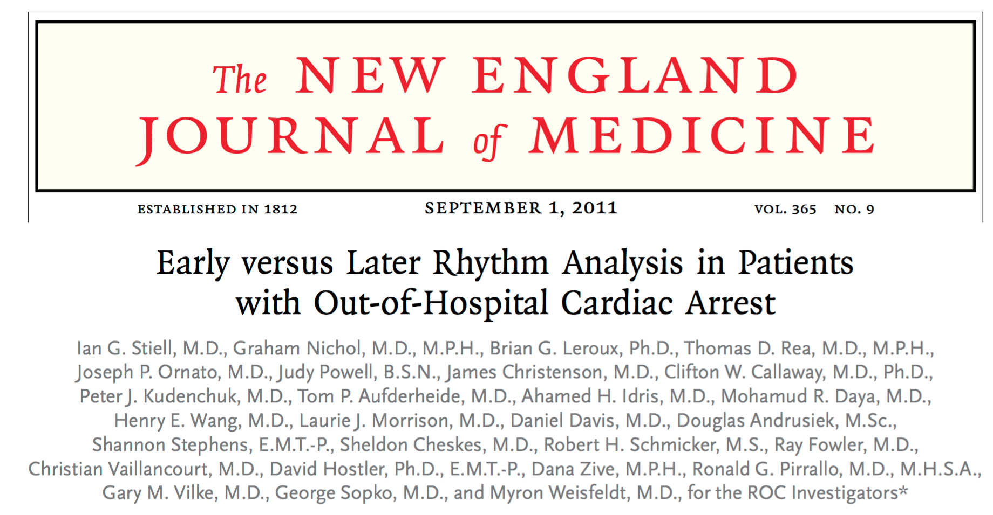
No Benefit

Slide 15
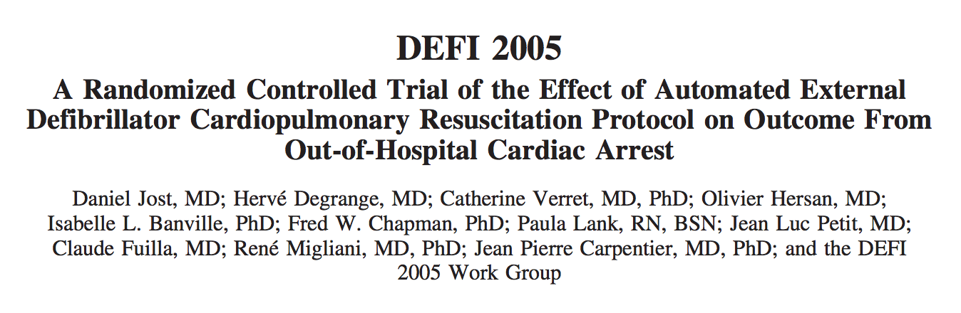

Slide 16
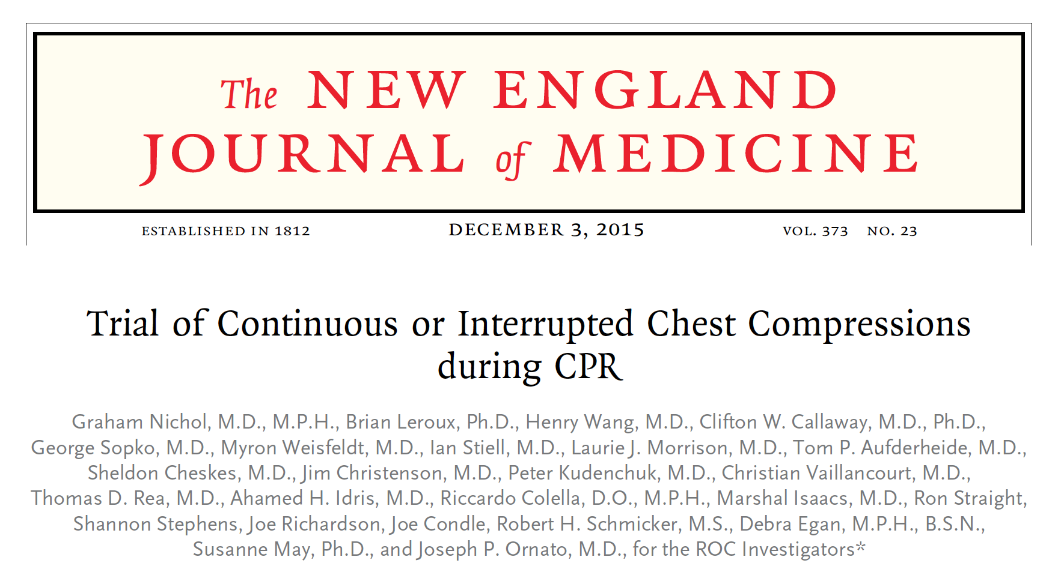

Slide 17

Mechanical CPR

Slide 18
Flawed
ROSC
CPP

Slide 19

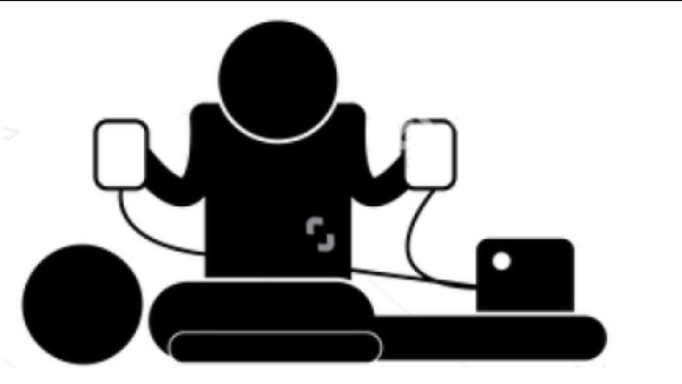
Chance of Successful Resuscitation
% ROSC
Time (min)

Slide 20


